Slide 1
Notes:
Okay, so if this activity is working, you should see a black triangle and a black circle.

Slide 2
ScaleV2_Training

Slide 3
Notes:
In this activity, I want to know how SURE you are that the GREEN answer or BLUE answer is more right, and [SLIDE] we’ll use these colors to answer.
[]
So let’s see how our scale of colors works.
[]
If you think either answer could be right — like, they’re they same, or you’re just not sure either way, you can just say “same” [ARROW], because it’s right in the middle. But [ARROW] the mooore you think the GREEN answer is right, the mooore you go this way. And [ARROW] the mooore you think the BLUE answer is right, the mooore you go this way.
[]
Okay? So let’s see some examples.

Slide 4
Notes:
In this activity, I want to know how SURE you are that the GREEN answer or BLUE answer is more right, and [SLIDE] we’ll use these colors to answer.
[]
So let’s see how our scale of colors works.
[]
If you think either answer could be right — like, they’re they same, or you’re just not sure either way, you can just say “same” [ARROW], because it’s right in the middle. But [ARROW] the mooore you think the GREEN answer is right, the mooore you go this way. And [ARROW] the mooore you think the BLUE answer is right, the mooore you go this way.
[]
Okay? So let’s see some examples.

Slide 5
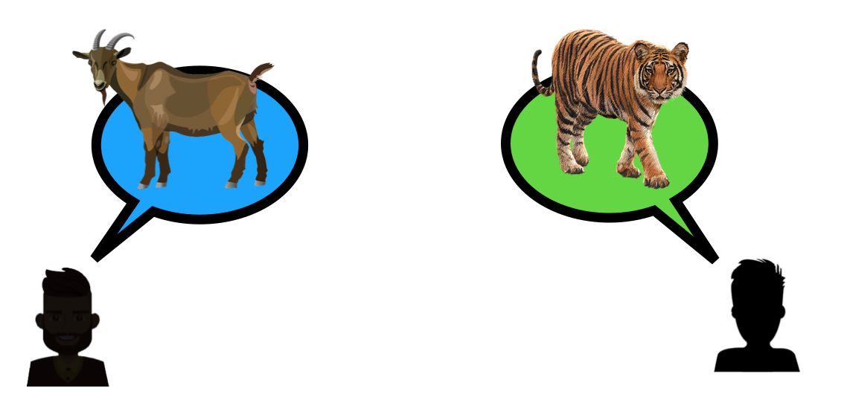
Training_Goat
Notes:
Which animal do you think is MORE dangerous: a tiger, in green, a goat, in blue, or are they the same??
[]
[must answer tiger: CORRECT them if not right]
[]
Yeah, I think a tiger is more dangerous than a goat. But how SURE are you? [SLIDE] Are you….

Slide 6
Training_Goat
Notes:
…just a little sure…

Slide 7
Training_Goat
Notes:
….pretty sure….

Slide 8
Training_Goat
Notes:
…or VERY sure?
[]
[must answer VERY: CORRECT if not right, e.g., “hmm, I don’t know. I think I would even be VERY sure that a tiger is more dangerous, because tigers are really big and have really big teeth, and could eat a goat right up!]
[]

Slide 9
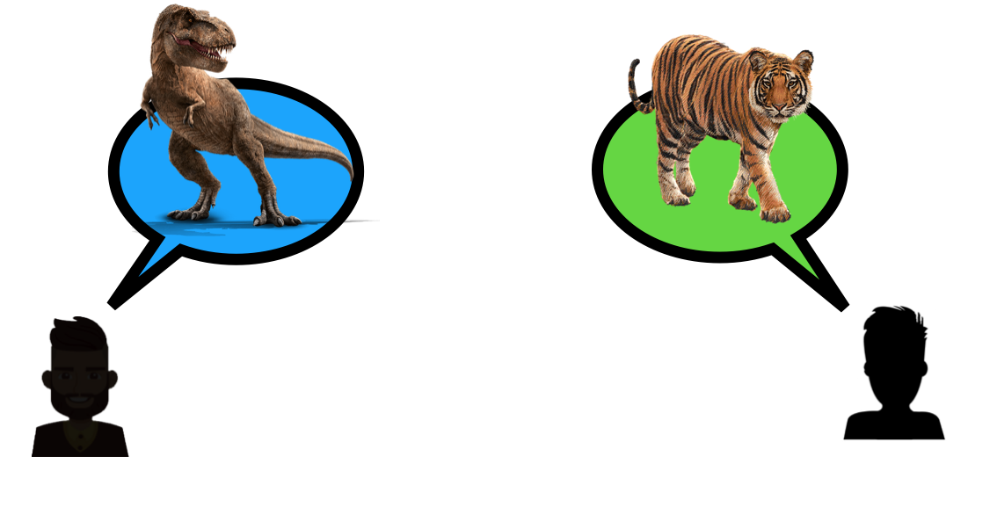
Training_TRex
Notes:
Which animal do you think is MORE dangerous: a tiger, in green, a tyrannosaurus, in blue, or are they the same? Can you tell me using the scale?
[]
[must answer t-rex: CORRECT them if not right]
[]
Yeah, I think a tyrannosaurus is more dangerous than a tiger. But how SURE are you? [SLIDE] Are you….

Slide 10
Training_TRex
Notes:
…just a little sure…

Slide 11
Training_TRex
Notes:
….pretty sure….

Slide 12
Training_TRex
Notes:
…or VERY sure?
[]
[]
[must answer VERY: correct them if not, e.g., “hmm, I don’t know. I think I would even be VERY sure that a tyrannosaurus is more dangerous, because even though tigers are really big, a tyrannosaurus is much bigger, and could eat a tiger in just one bite!]
[]

Slide 13
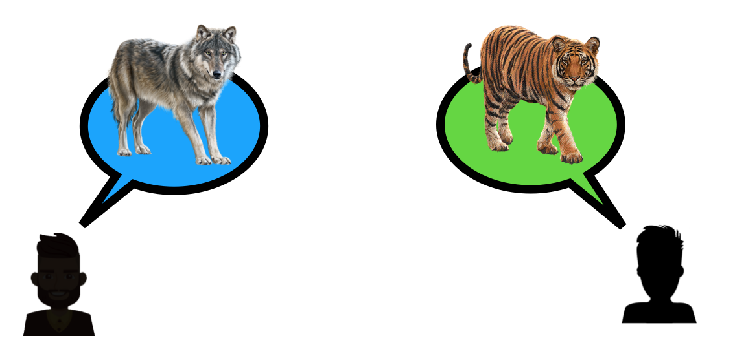
Training_Wolf
Notes:
Which animal do you think is MORE dangerous: a tiger, in green, a wolf, in blue, or are they the same?
[]
Okay, and how SURE are you? Are you just a little sure, pretty sure, or VERY sure?
[]
[IF THEY SAY WOLF: suggest you’d be “a little or even pretty sure” tiger, because tigers are really big, and wolves just a bit bigger than big dogs — but that it could be wolf too]

Slide 14
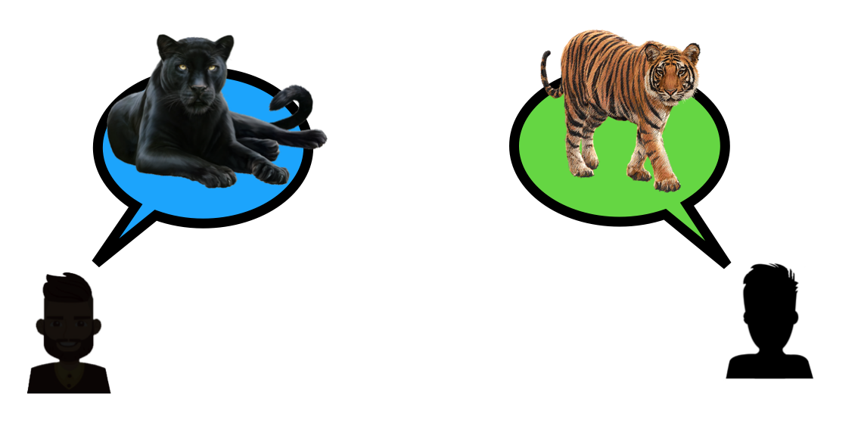
Training_Panther
Notes:
Which animal do you think is MORE dangerous: a tiger, in green, a panther, in blue, or are they the same?
[]
Okay, and how SURE are you? Are you just a little sure, pretty sure, or VERY sure?
[]
[CAN DO CHEETAH if you doubt whether they understand the scale, OTHERWISE GO TO SLIDE 16]

Slide 15
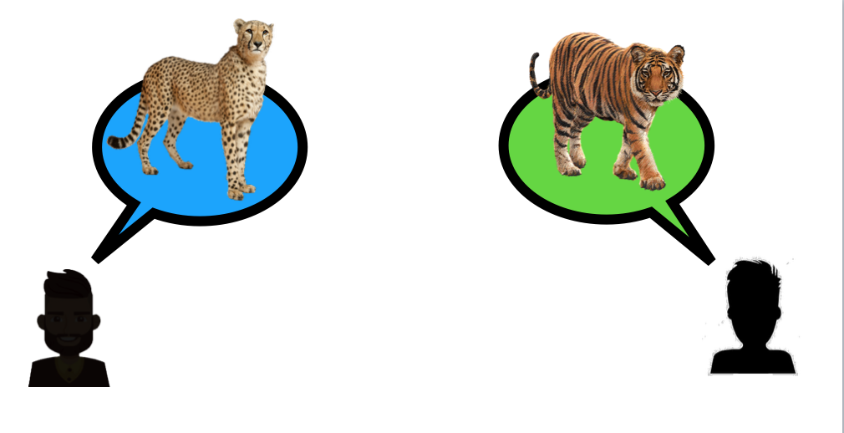
Training_Cheetah
Notes:
Which animal do you think is MORE dangerous: a tiger, in green, a cheetah, in blue, or are they the same?
[]
Okay, and how SURE are you? Are you just a little sure, pretty sure, or VERY sure?

Slide 16
Notes:
Okay, so that’s how we’ll answers questions in this activity. For for each question, I’ll ask you whether the blue answer or the green answer is more right, and then I’ll ask you how sure you are — and if you think that both answers are right, you can just say “the same”.
[]
CONDITIONS: Go to corresponding slides
[]
D_S_DS: Slide 17 S_D_DS: Slide 43
DS_D_S: Slide 69
DS_S_D: Slide 95 []
NOTE: Remember that there is a “physical” control question (“build”) on Slide 121

Slide 17
Intro: D_S_DS
Notes:
In this activity, your job will be to say which team you think will take LONGER to decide something. So, in this activity, you’ll see some people making remote control drones. To make a drone, you first build a body out of plastic. Then, you have to buy a little tiny computer to put on the drone to help it balance. Then, you have to build your own engine, and hook it up to the wings to that hold the propellers.
[]
And, then you have to decide what KIND of propeller [SLIDE]…

Slide 18
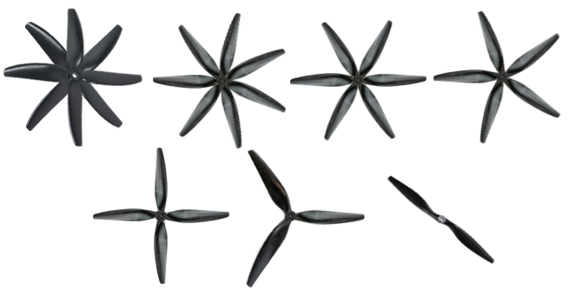
Notes:
…will make your drone fly the best. The propellers can have TWO blades, or EIGHT blades, or any number in between. But people don’t always agree about how many blades the propellers should have to make the drone fly the best. So when they disagree, the people have to talk together to decide what kind of propeller to use.
[]
So, I’m going to show you two teams of people: [SLIDE] …

Slide 19
Notes:
…the GREEN team, and the BLUE team.
[]
And I’ll show you [SLIDE] …

Slide 20
Notes:
…what kind of propeller EACH person in EACH team thinks is best.
[]
Your job will be to say which team you think will take LONGER to decide what kind of propeller to use.
[]
So, these …

Slide 21
Diversity
Notes:
IF FIRST QUESTION: [SLIDE]
IF NOT FIRST: Now let’s see what happened with some DIFFERENT groups. This time, these…

Slide 22
Notes:
…are the people making drones.
[]
And these people…

Slide 23
Notes:
… are on the GREEN team. And these people…

Slide 24
Notes:
are on the BLUE team.
[]
Now, the people on the GREEN team disagree about what kind of propeller to use [SLIDE]

Slide 25
Notes:
So now, each person on the GREEN team is standing next to the propeller they think is best.
[]
And, the people on the BLUE team disagree about what kind of propeller to use too [SLIDE].

Slide 26
Notes:
And now each person on the BLUE team is standing next to the propeller they think is best.
[]
But the GREEN team can only build ONE drone, and the BLUE team can only build ONE drone. So each team has to decide which kind of propeller will make their drone fly the best.
[]
So now, ALL [ARROW] the people on the GREEN team have to talk together to decide which propeller to use. And ALL [ARROW] the people on the BLUE team have to talk together to decide which which propeller to use.
[]
But, [CHILD NAME]…

Slide 27
Notes:
But, which team will take LONGER to decide: the GREEN team, the BLUE team, or will it be the same?
[]
Okay! And how SURE are you? Are you just a little sure, pretty sure, or VERY sure?
[]
Okay! And why do you think the [child’s answer: GREEN/BLUE] team will take longer to decide?

Slide 28
Size
Notes:
IF FIRST QUESTION: [SLIDE]
IF NOT FIRST: Now let’s see what happened with some DIFFERENT groups. This time, these…

Slide 29
Notes:
…are the people making drones.
[]
And these people…

Slide 30
Notes:
… are on the GREEN team. And these people…

Slide 31
Notes:
are on the BLUE team.
[]
Now, the people on the GREEN team disagree about what kind of propeller to use [SLIDE]

Slide 32
Notes:
So now, each person on the GREEN team is standing next to the propeller they think is best.
[]
And, the people on the BLUE team disagree about what kind of propeller to use too [SLIDE].

Slide 33
Notes:
And now each person on the BLUE team is standing next to the propeller they think is best.
[]
But the GREEN team can only build ONE drone, and the BLUE team can only build ONE drone. So each team has to decide which kind of propeller will make their drone fly the best.
[]
So now, ALL [ARROW] the people on the GREEN team have to talk together to decide which propeller to use. And ALL [ARROW] the people on the BLUE team have to talk together to decide which which propeller to use.
[]
But, [CHILD NAME]…

Slide 34
Notes:
But, which team will take LONGER to decide: the GREEN team, the BLUE team, or will it be the same?
[]
Okay! And how SURE are you? Are you just a little sure, pretty sure, or VERY sure?
[]
Okay! And why do you think the [child’s answer: GREEN/BLUE] team will take longer to decide?

Slide 35
Div_Size
Notes:
IF FIRST QUESTION: [SLIDE]
IF NOT FIRST: Now let’s see what happened with some DIFFERENT groups. This time, these…

Slide 36
Notes:
…are the people making drones.
[]
And these people…

Slide 37
Notes:
… are on the GREEN team. And these people…

Slide 38
Notes:
are on the BLUE team.
[]
Now, the people on the GREEN team disagree about what kind of propeller to use [SLIDE]

Slide 39
Notes:
So now, each person on the GREEN team is standing next to the propeller they think is best.
[]
And, the people on the BLUE team disagree about what kind of propeller to use too [SLIDE].

Slide 40
Notes:
And now each person on the BLUE team is standing next to the propeller they think is best.
[]
But the GREEN team can only build ONE drone, and the BLUE team can only build ONE drone. So each team has to decide which kind of propeller will make their drone fly the best.
[]
So now, ALL [ARROW] the people on the GREEN team have to talk together to decide which propeller to use. And ALL [ARROW] the people on the BLUE team have to talk together to decide which which propeller to use.
[]
But, [CHILD NAME]…

Slide 41
Notes:
But, which team will take LONGER to decide: the GREEN team, the BLUE team, or will it be the same?
[]
Okay! And how SURE are you? Are you just a little sure, pretty sure, or VERY sure?
[]
Okay! And why do you think the [child’s answer: GREEN/BLUE] team will take longer to decide?

Slide 42
S_D_DS

Slide 43
Intro: S_D_DS
Notes:
In this activity, your job will be to say which team you think will take LONGER to decide something. So, in this activity, you’ll see some people making remote control drones. To make a drone, you first build a body out of plastic. Then, you have to buy a little tiny computer to put on the drone to help it balance. Then, you have to build your own engine, and hook it up to the wings to that hold the propellers.
[]
And, then you have to decide what KIND of propeller [SLIDE]…

Slide 44
Notes:
…will make your drone fly the best. The propellers can have TWO blades, or EIGHT blades, or any number in between. But people don’t always agree about how many blades the propellers should have to make the drone fly the best. So when they disagree, the people have to talk together to decide what kind of propeller to use.
[]
So, I’m going to show you two teams of people: [SLIDE] …

Slide 45
Notes:
…the GREEN team, and the BLUE team.
[]
And I’ll show you [SLIDE] …

Slide 46
Notes:
…what kind of propeller EACH person in EACH team thinks is best.
[]
Your job will be to say which team you think will take LONGER to decide what kind of propeller to use.
[]
So, these …

Slide 47
Size
Notes:
IF FIRST QUESTION: [SLIDE]
IF NOT FIRST: Now let’s see what happened with some DIFFERENT groups. This time, these…

Slide 48
Notes:
…are the people making drones.
[]
And these people…

Slide 49
Notes:
… are on the GREEN team. And these people…

Slide 50
Notes:
are on the BLUE team.
[]
Now, the people on the GREEN team disagree about what kind of propeller to use [SLIDE]

Slide 51
Notes:
So now, each person on the GREEN team is standing next to the propeller they think is best.
[]
And, the people on the BLUE team disagree about what kind of propeller to use too [SLIDE].

Slide 52
Notes:
And now each person on the BLUE team is standing next to the propeller they think is best.
[]
But the GREEN team can only build ONE drone, and the BLUE team can only build ONE drone. So each team has to decide which kind of propeller will make their drone fly the best.
[]
So now, ALL [ARROW] the people on the GREEN team have to talk together to decide which propeller to use. And ALL [ARROW] the people on the BLUE team have to talk together to decide which which propeller to use.
[]
But, [CHILD NAME]…

Slide 53
Notes:
But, which team will take LONGER to decide: the GREEN team, the BLUE team, or will it be the same?
[]
Okay! And how SURE are you? Are you just a little sure, pretty sure, or VERY sure?
[]
Okay! And why do you think the [child’s answer: GREEN/BLUE] team will take longer to decide?

Slide 54
Diversity
Notes:
IF FIRST QUESTION: [SLIDE]
IF NOT FIRST: Now let’s see what happened with some DIFFERENT groups. This time, these…

Slide 55
Notes:
…are the people making drones.
[]
And these people…

Slide 56
Notes:
… are on the GREEN team. And these people…

Slide 57
Notes:
are on the BLUE team.
[]
Now, the people on the GREEN team disagree about what kind of propeller to use [SLIDE]

Slide 58
Notes:
So now, each person on the GREEN team is standing next to the propeller they think is best.
[]
And, the people on the BLUE team disagree about what kind of propeller to use too [SLIDE].

Slide 59
Notes:
And now each person on the BLUE team is standing next to the propeller they think is best.
[]
But the GREEN team can only build ONE drone, and the BLUE team can only build ONE drone. So each team has to decide which kind of propeller will make their drone fly the best.
[]
So now, ALL [ARROW] the people on the GREEN team have to talk together to decide which propeller to use. And ALL [ARROW] the people on the BLUE team have to talk together to decide which which propeller to use.
[]
But, [CHILD NAME]…

Slide 60
Notes:
But, which team will take LONGER to decide: the GREEN team, the BLUE team, or will it be the same?
[]
Okay! And how SURE are you? Are you just a little sure, pretty sure, or VERY sure?
[]
Okay! And why do you think the [child’s answer: GREEN/BLUE] team will take longer to decide?

Slide 61
Div_Size
Notes:
IF FIRST QUESTION: [SLIDE]
IF NOT FIRST: Now let’s see what happened with some DIFFERENT groups. This time, these…

Slide 62
Notes:
…are the people making drones.
[]
And these people…

Slide 63
Notes:
… are on the GREEN team. And these people…

Slide 64
Notes:
are on the BLUE team.
[]
Now, the people on the GREEN team disagree about what kind of propeller to use [SLIDE]

Slide 65
Notes:
So now, each person on the GREEN team is standing next to the propeller they think is best.
[]
And, the people on the BLUE team disagree about what kind of propeller to use too [SLIDE].

Slide 66
Notes:
And now each person on the BLUE team is standing next to the propeller they think is best.
[]
But the GREEN team can only build ONE drone, and the BLUE team can only build ONE drone. So each team has to decide which kind of propeller will make their drone fly the best.
[]
So now, ALL [ARROW] the people on the GREEN team have to talk together to decide which propeller to use. And ALL [ARROW] the people on the BLUE team have to talk together to decide which which propeller to use.
[]
But, [CHILD NAME]…

Slide 67
Notes:
But, which team will take LONGER to decide: the GREEN team, the BLUE team, or will it be the same?
[]
Okay! And how SURE are you? Are you just a little sure, pretty sure, or VERY sure?
[]
Okay! And why do you think the [child’s answer: GREEN/BLUE] team will take longer to decide?

Slide 68
DS_D_S

Slide 69
Intro: DS_D_S
Notes:
In this activity, your job will be to say which team you think will take LONGER to decide something. So, in this activity, you’ll see some people making remote control drones. To make a drone, you first build a body out of plastic. Then, you have to buy a little tiny computer to put on the drone to help it balance. Then, you have to build your own engine, and hook it up to the wings to that hold the propellers.
[]
And, then you have to decide what KIND of propeller [SLIDE]…

Slide 70
Notes:
…will make your drone fly the best. The propellers can have TWO blades, or EIGHT blades, or any number in between. But people don’t always agree about how many blades the propellers should have to make the drone fly the best. So when they disagree, the people have to talk together to decide what kind of propeller to use.
[]
So, I’m going to show you two teams of people: [SLIDE] …

Slide 71
Notes:
…the GREEN team, and the BLUE team.
[]
And I’ll show you [SLIDE] …

Slide 72
Notes:
…what kind of propeller EACH person in EACH team thinks is best.
[]
Your job will be to say which team you think will take LONGER to decide what kind of propeller to use.
[]
So, these …

Slide 73
Div_Size
Notes:
IF FIRST QUESTION: [SLIDE]
IF NOT FIRST: Now let’s see what happened with some DIFFERENT groups. This time, these…

Slide 74
Notes:
…are the people making drones.
[]
And these people…

Slide 75
Notes:
… are on the GREEN team. And these people…

Slide 76
Notes:
are on the BLUE team.
[]
Now, the people on the GREEN team disagree about what kind of propeller to use [SLIDE]

Slide 77
Notes:
So now, each person on the GREEN team is standing next to the propeller they think is best.
[]
And, the people on the BLUE team disagree about what kind of propeller to use too [SLIDE].

Slide 78
Notes:
And now each person on the BLUE team is standing next to the propeller they think is best.
[]
But the GREEN team can only build ONE drone, and the BLUE team can only build ONE drone. So each team has to decide which kind of propeller will make their drone fly the best.
[]
So now, ALL [ARROW] the people on the GREEN team have to talk together to decide which propeller to use. And ALL [ARROW] the people on the BLUE team have to talk together to decide which which propeller to use.
[]
But, [CHILD NAME]…

Slide 79
Notes:
But, which team will take LONGER to decide: the GREEN team, the BLUE team, or will it be the same?
[]
Okay! And how SURE are you? Are you just a little sure, pretty sure, or VERY sure?
[]
Okay! And why do you think the [child’s answer: GREEN/BLUE] team will take longer to decide?

Slide 80
Diversity
Notes:
IF FIRST QUESTION: [SLIDE]
IF NOT FIRST: Now let’s see what happened with some DIFFERENT groups. This time, these…

Slide 81
Notes:
…are the people making drones.
[]
And these people…

Slide 82
Notes:
… are on the GREEN team. And these people…

Slide 83
Notes:
are on the BLUE team.
[]
Now, the people on the GREEN team disagree about what kind of propeller to use [SLIDE]

Slide 84
Notes:
So now, each person on the GREEN team is standing next to the propeller they think is best.
[]
And, the people on the BLUE team disagree about what kind of propeller to use too [SLIDE].

Slide 85
Notes:
And now each person on the BLUE team is standing next to the propeller they think is best.
[]
But the GREEN team can only build ONE drone, and the BLUE team can only build ONE drone. So each team has to decide which kind of propeller will make their drone fly the best.
[]
So now, ALL [ARROW] the people on the GREEN team have to talk together to decide which propeller to use. And ALL [ARROW] the people on the BLUE team have to talk together to decide which which propeller to use.
[]
But, [CHILD NAME]…

Slide 86
Notes:
But, which team will take LONGER to decide: the GREEN team, the BLUE team, or will it be the same?
[]
Okay! And how SURE are you? Are you just a little sure, pretty sure, or VERY sure?
[]
Okay! And why do you think the [child’s answer: GREEN/BLUE] team will take longer to decide?

Slide 87
Size
Notes:
IF FIRST QUESTION: [SLIDE]
IF NOT FIRST: Now let’s see what happened with some DIFFERENT groups. This time, these…

Slide 88
Notes:
…are the people making drones.
[]
And these people…

Slide 89
Notes:
… are on the GREEN team. And these people…

Slide 90
Notes:
are on the BLUE team.
[]
Now, the people on the GREEN team disagree about what kind of propeller to use [SLIDE]

Slide 91
Notes:
So now, each person on the GREEN team is standing next to the propeller they think is best.
[]
And, the people on the BLUE team disagree about what kind of propeller to use too [SLIDE].

Slide 92
Notes:
And now each person on the BLUE team is standing next to the propeller they think is best.
[]
But the GREEN team can only build ONE drone, and the BLUE team can only build ONE drone. So each team has to decide which kind of propeller will make their drone fly the best.
[]
So now, ALL [ARROW] the people on the GREEN team have to talk together to decide which propeller to use. And ALL [ARROW] the people on the BLUE team have to talk together to decide which which propeller to use.
[]
But, [CHILD NAME]…

Slide 93
Notes:
But, which team will take LONGER to decide: the GREEN team, the BLUE team, or will it be the same?
[]
Okay! And how SURE are you? Are you just a little sure, pretty sure, or VERY sure?
[]
Okay! And why do you think the [child’s answer: GREEN/BLUE] team will take longer to decide?

Slide 94
Intro: DS_S_D

Slide 95
Intro: DS_S_D
Notes:
In this activity, your job will be to say which team you think will take LONGER to decide something. So, in this activity, you’ll see some people making remote control drones. To make a drone, you first build a body out of plastic. Then, you have to buy a little tiny computer to put on the drone to help it balance. Then, you have to build your own engine, and hook it up to the wings to that hold the propellers.
[]
And, then you have to decide what KIND of propeller [SLIDE]…

Slide 96
Notes:
…will make your drone fly the best. The propellers can have TWO blades, or EIGHT blades, or any number in between. But people don’t always agree about how many blades the propellers should have to make the drone fly the best. So when they disagree, the people have to talk together to decide what kind of propeller to use.
[]
So, I’m going to show you two teams of people: [SLIDE] …

Slide 97
Notes:
…the GREEN team, and the BLUE team.
[]
And I’ll show you [SLIDE] …

Slide 98
Notes:
…what kind of propeller EACH person in EACH team thinks is best.
[]
Your job will be to say which team you think will take LONGER to decide what kind of propeller to use.
[]
So, these …

Slide 99
Div_Size
Notes:
IF FIRST QUESTION: [SLIDE]
IF NOT FIRST: Now let’s see what happened with some DIFFERENT groups. This time, these…

Slide 100
Notes:
…are the people making drones.
[]
And these people…

Slide 101
Notes:
… are on the GREEN team. And these people…

Slide 102
Notes:
are on the BLUE team.
[]
Now, the people on the GREEN team disagree about what kind of propeller to use [SLIDE]

Slide 103
Notes:
So now, each person on the GREEN team is standing next to the propeller they think is best.
[]
And, the people on the BLUE team disagree about what kind of propeller to use too [SLIDE].

Slide 104
Notes:
And now each person on the BLUE team is standing next to the propeller they think is best.
[]
But the GREEN team can only build ONE drone, and the BLUE team can only build ONE drone. So each team has to decide which kind of propeller will make their drone fly the best.
[]
So now, ALL [ARROW] the people on the GREEN team have to talk together to decide which propeller to use. And ALL [ARROW] the people on the BLUE team have to talk together to decide which which propeller to use.
[]
But, [CHILD NAME]…

Slide 105
Notes:
But, which team will take LONGER to decide: the GREEN team, the BLUE team, or will it be the same?
[]
Okay! And how SURE are you? Are you just a little sure, pretty sure, or VERY sure?
[]
Okay! And why do you think the [child’s answer: GREEN/BLUE] team will take longer to decide?

Slide 106
Size
Notes:
IF FIRST QUESTION: [SLIDE]
IF NOT FIRST: Now let’s see what happened with some DIFFERENT groups. This time, these…

Slide 107
Notes:
…are the people making drones.
[]
And these people…

Slide 108
Notes:
… are on the GREEN team. And these people…

Slide 109
Notes:
are on the BLUE team.
[]
Now, the people on the GREEN team disagree about what kind of propeller to use [SLIDE]

Slide 110
Notes:
So now, each person on the GREEN team is standing next to the propeller they think is best.
[]
And, the people on the BLUE team disagree about what kind of propeller to use too [SLIDE].

Slide 111
Notes:
And now each person on the BLUE team is standing next to the propeller they think is best.
[]
But the GREEN team can only build ONE drone, and the BLUE team can only build ONE drone. So each team has to decide which kind of propeller will make their drone fly the best.
[]
So now, ALL [ARROW] the people on the GREEN team have to talk together to decide which propeller to use. And ALL [ARROW] the people on the BLUE team have to talk together to decide which which propeller to use.
[]
But, [CHILD NAME]…

Slide 112
Notes:
But, which team will take LONGER to decide: the GREEN team, the BLUE team, or will it be the same?
[]
Okay! And how SURE are you? Are you just a little sure, pretty sure, or VERY sure?
[]
Okay! And why do you think the [child’s answer: GREEN/BLUE] team will take longer to decide?

Slide 113
Diversity
Notes:
IF FIRST QUESTION: [SLIDE]
IF NOT FIRST: Now let’s see what happened with some DIFFERENT groups. This time, these…

Slide 114
Notes:
…are the people making drones.
[]
And these people…

Slide 115
Notes:
… are on the GREEN team. And these people…

Slide 116
Notes:
are on the BLUE team.
[]
Now, the people on the GREEN team disagree about what kind of propeller to use [SLIDE]

Slide 117
Notes:
So now, each person on the GREEN team is standing next to the propeller they think is best.
[]
And, the people on the BLUE team disagree about what kind of propeller to use too [SLIDE].

Slide 118
Notes:
And now each person on the BLUE team is standing next to the propeller they think is best.
[]
But the GREEN team can only build ONE drone, and the BLUE team can only build ONE drone. So each team has to decide which kind of propeller will make their drone fly the best.
[]
So now, ALL [ARROW] the people on the GREEN team have to talk together to decide which propeller to use. And ALL [ARROW] the people on the BLUE team have to talk together to decide which which propeller to use.
[]
But, [CHILD NAME]…

Slide 119
Notes:
But, which team will take LONGER to decide: the GREEN team, the BLUE team, or will it be the same?
[]
Okay! And how SURE are you? Are you just a little sure, pretty sure, or VERY sure?
[]
Okay! And why do you think the [child’s answer: GREEN/BLUE] team will take longer to decide?

Slide 121
BUILD: Div_VS_Size
Notes:
Okay, so now I have a little bit of a different kind of question. This time, I want to know which group you think will take longer to BUILD their drone.
[]
So, I’ll show you two more teams. But in these two teams, the people have ALREADY DECIDED which propeller to use. So, they ALL AGREE about how to build their drone, and they just need to actually BUILD their drone. So, both teams start at the SAME TIME. Your job will be to tell me which team you think will take LONGER to finish BUILDING their drone.
[]
So this time, these…

Slide 122
Notes:
…are the people making drones.
[]
And these people…

Slide 123
Notes:
… are on the GREEN team. And these people…

Slide 124
Notes:
are on the BLUE team.
[]
Now, both teams have ALREADY DECIDED which propeller to use, and they all agree. And both teams will start building at the same time.
[]
But, [CHILD NAME]….

Slide 125
Notes:
…which team will take LONGER to BUILD their drone: the GREEN team, the BLUE team, or will it be the same?
[]
[]
Okay! And how SURE are you? Are you just a little sure, pretty sure, or VERY sure?
[]
Okay! And why do you think the [child’s answer: GREEN/BLUE] team will take longer to build their drone?

